Slide 1
NLP Preprocessing Techniques
School of infocomm
Notes:
Welcome to Week 2! Today we’ll show you some of the most popular NLP libraries in Python, and also go through a series of preprocessing techniques. Text data is typically quite messy, so a lot of preprocessing has to be done before you can do any analysis.

Slide 2
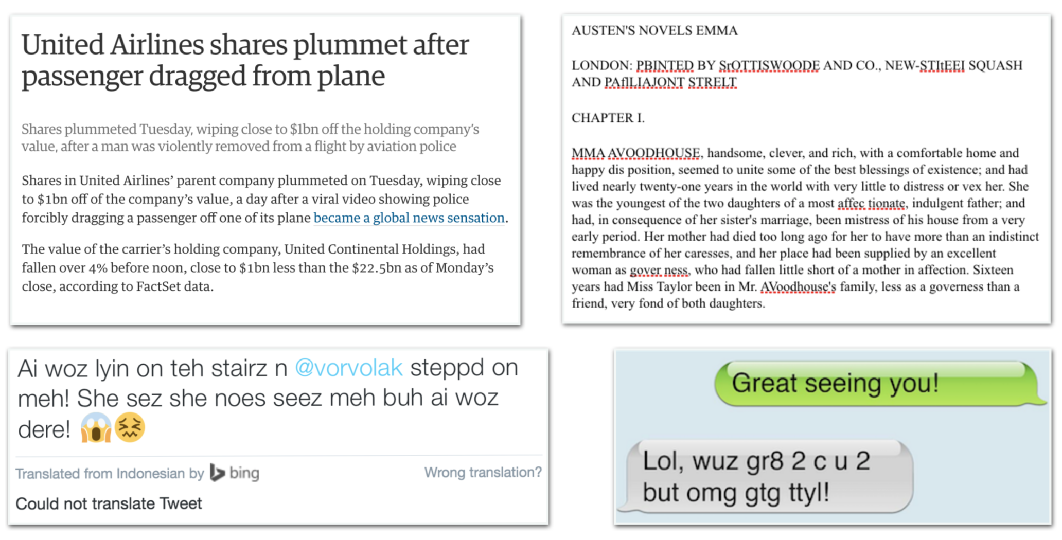
Text is Unstructured and Noisy!
Notes:
Most text data arrives in an unstructured form without any pre- defined organisation or format, beyond natural language.
The vocabulary, formatting, and quality of the text can vary significantly.
Look at the twitter post: can you figure out is been said there ?
So, before any one can say things like let's do text analytics, or run some sentiment analysis on say food review, there has too be some effort taken to prepare the data. At least to get in to the point where some noises are removed, get rides of things that are not useful, correct spelling mistakes etc.

Slide 3


Software / Libraries
See https://medium.com/activewizards-machine-learning-company/comparison-of-top-6-python-nlp-libraries-c4ce160237eb
Notes:
So there are some very cool took kits out there.
On left, are the "getting started" tool kits and library.
NLTK - Pretty much everyone starts here. It iis really good for text pre-processing activities and comes with a rich set of corpus for people to try different NLP adk.
spaCy - This is up and coming. It's marketed as an "industrial-strength" Python NLP library that's geared toward performance.
Scikit-learn – If you have already learned machine learning, you should have come across this. We can use some of the modules within to perform classifications and dimension reduction of text.
gensim - We will be going over this later in the course.
OpenNLP – Commandline based interface and API for Java

Slide 4
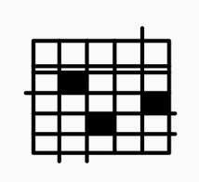

Text Preprocessing Activities
Goal: Converting unstructured text to a meaningful format for analysis
Case conversion
Tokenization
Remove punctuations
Corpus of raw documents
Normalize text
Data structure (features) representing text
Remove stop words
Extract compound terms
Strip special characters and noises
Notes:
So, for our purpose, we want to guide you through some commonly used methods that can be used to pre-processed text.
I want to emphasis these methods are for now geared towards languages like English where words are formed from characters.
So a quick overview, normally , we start with a huge volume of text , call a corpus.
We have to cut in down into smaller pieces, a process call tokenization.
Then, at the tokenized level, we may consider some additional preparation work as listed in the method.
At the end of the it, our text can be prepared into structured form, where it is ready for further analysis.
For this lesson, we will stop at at the preprocessing task, and leave the data structure part for the afternoon.

Slide 5
Introducing NLTK (Natural Language Toolkit)
NLTK is a popular platform for building Python programs to work with human language data
It provides easy-to-use interfaces to over 50 corpora, lexical resources and trained models.
http://www.nltk.org/nltk_data/
Has a suite of text processing libraries for tokenization, stemming, tagging, parsing, semantic reasoning, classifications, wrappers for other NLP libraries

Slide 6
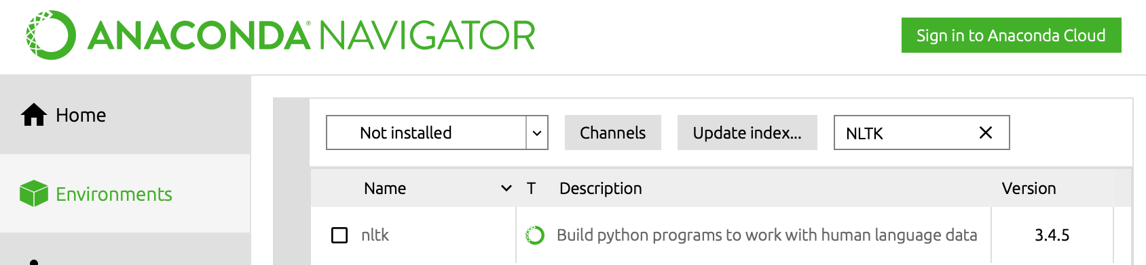
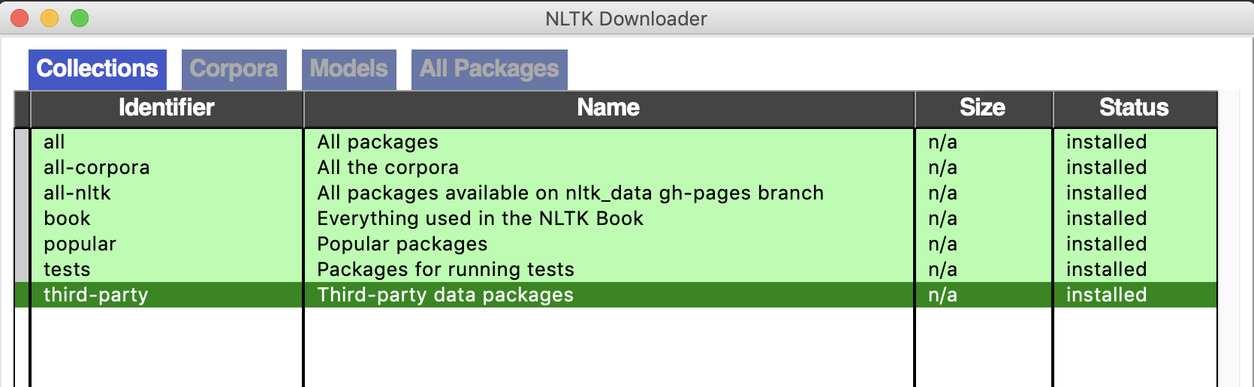
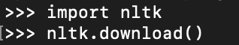
How to Install NLTK
1. Install package from Anaconda
From Anaconda Navigato
2. Download all data and models from Python shell
Notes:
After doing nltk.download(), choose to download all in the GUI. This will give you all the tokenizers, chunkers, algorithms and corporas.
The students should run this code now, so everything will be ready in time for when they do the exercises. It takes about 15 minutes.

Slide 7
Exercise: What are some things you should do to prepare for text analysis?
Hi Mr. Smith! I’m going to buy some vegetables (tomatoes and cucumbers) from the store. Should i pick up some black-eyed peas as well?
Notes:
This is a brain storm exercise:
Goal #1: is the find a way to break into smaller pieces
Goal #2: Find ways to clean the data / tokens
Some ideas:
How to seperate the punctuation form the words
I'm oto I am

Slide 8
Preprocessing Techniques
Turn text into a meaningful format for analysis
Tokenization
Clean the data
Remove - capital letters, punctuation, stop words
Normalization - stemming, lemmatization
Chunking - compound terms, multi-words phrases
Notes:
Tokenization is the process of dividing our data into the smaller units that we will analyze
Chunking is a general term. It means to extract meaningful units, or chunks, of text from raw text.

Slide 9
Tokenization
Tokenization = splitting raw text into small, indivisible units for processing
These units can be:
Sentences
Words
N-grams
Notes:
For most purposes, we will be splitting our text up into words, but there are many options out there for splitting text up.
A word you might not have seen before is ‘n-gram’, which means a sequence of n items from a text. These ‘items’ might be syllables, letters, words, etc. but usually refer to words. Researchers usually vary the size of their n gram depending on their application.
Example: “Hi my name is Rick” -> [(Hi, my), (my, name), (name, is), (is, Rick)] would be an example of splitting up a piece of text into 2-grams (called bigrams).
We will see how to do this automatically using nltk later in the slides.

Slide 10
Tokenization: Sentences / words
Hi Mr. Smith! I’m going to buy some vegetables (tomatoes and cucumbers) from the store. Should i pick up some black-eyed peas as well?
Tokens can be sentences or words.
How would you split this into sentences?
What rules would you put in place?
It’s a difficult task. This is where NLTK tokenizers in Python can help.
Notes:
Lecturer Notes and Guides
We can pause here.
Ask students how to get statements from this?
How can you determine end of a statement?
How can you determine to start of a statement.
You can't go by Capitalization (Mr Month will give you some trouble)
You can't go by punctuation
You might say that capitalization or punctuation are good places to start but as you can see proper nouns (Smith) and titles (Mr.) are two examples of common words that break those rules for tokenization
This is where built-in tokenizers can help

Slide 11
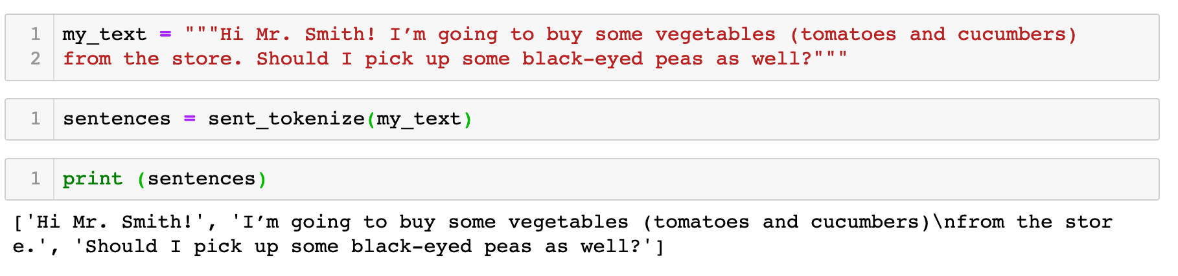
Code: Sentence Tokenization (Text → Sentences)
Refer to nltk-example-1-tokenization-sentence.ipynb
Notes:
Lecturer Note:
As you can see, developers have been hard at work to make sure that tokenizers are able to accurately pick out sentences from a piece of text.
What if you want to take it a step further a break into words instead.

Slide 12
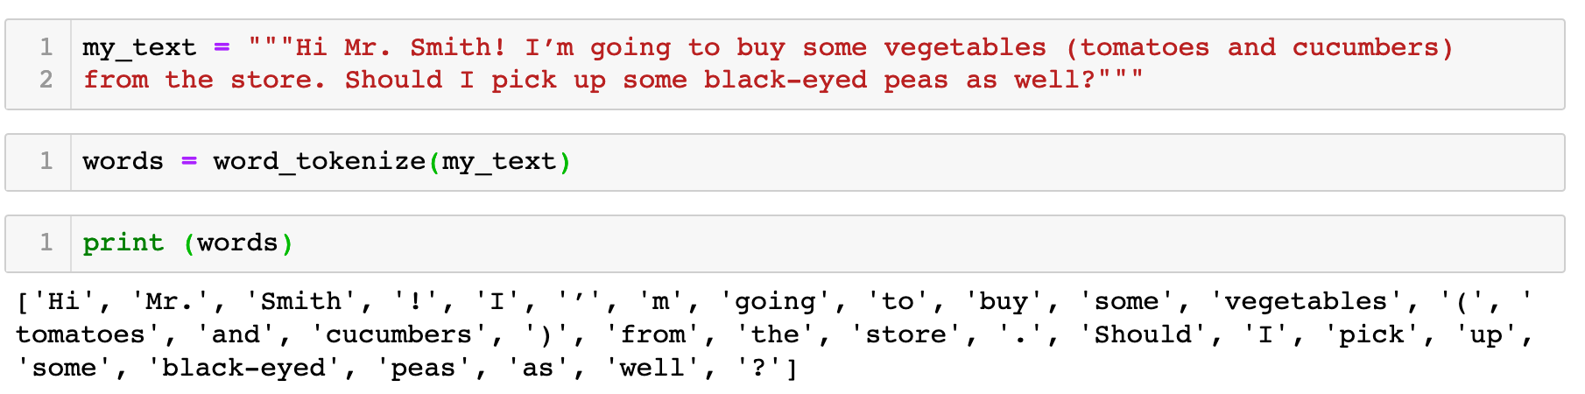
Code: Word Tokenization (Text → Words)
Ref to : nltk-example-2-tokenization-word.ipynb
Notes:
Now, upfront tokenizer into words isn't very helpful. You can see that the "sentence" information is somehow lost!
To overcome this problem, we can take a two step tokenizing approach.
We can break the text into sentences, and within the sentences break into tokens.
So, in this example, the output is a list. It cantains 3 lists. Each sublist contains the words related to the sentences
Question for students: Can you spot the word that is "over tokenized". : Hint I'm

Slide 13
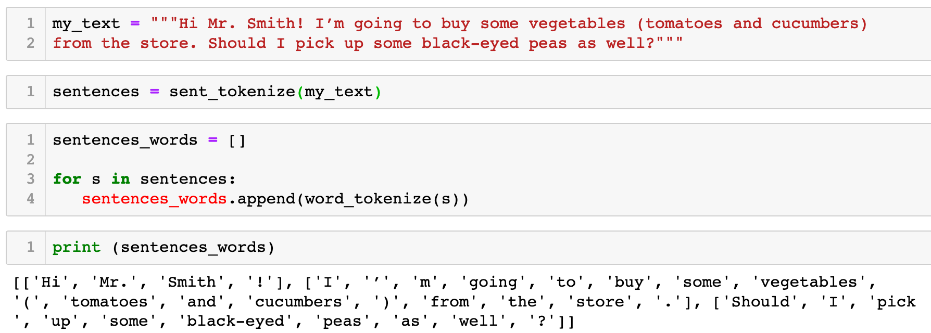
Code: Word Tokenization
(Text → Sentences → Words)
Refer to nltk-example-3-tokenization-sentence_word.ipynb
Notes:
Now, upfront tokenizer into words isn't very helpful. You can see that the "sentence" information is somehow lost!
To overcome this problem, we can take a two step tokenizing approach.
We can break the text into sentences, and within the sentences break into tokens.
So, in this example, the output is a list. It cantains 3 lists. Each sublist contains the words related to the sentences
Question for students: Can you spot the word that is "over tokenized". : Hint I'm

Slide 14
Tokenization: Regular Expressions
The results of word tokenization is not very satisfying.
Let’s say you want to tokenize by some other type of grouping or pattern based on the written characteristic of the language.
For English, some characteristics are:
- White spaces (\s+) between words
- Sentence starts with capital letters: [A-Z]['\w]+
- Sentence ends with punctuation (!?.)
Notes:
If you look at the results of tokenizing based on words, you will notice some unsatisfactory results.
For example I'm should be one logic unit, but the default tokenize breaks into three tokens.
The other is (tomatoes and cumbers), what if you need to keep to bracket together to

Slide 15
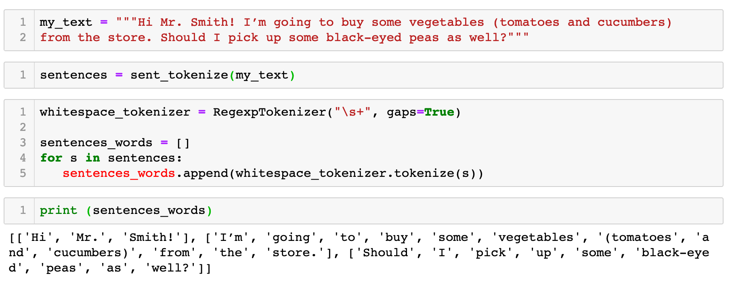
Code: Tokenization (Regular Expressions)
Refer to nltk-example-4-tokenization-regular-expression.ipynb
Notes:
In this example, the regular expression is \s+.
\s stands for “whitespace character.
So in this example, we are using space as the basics to cut up the statements. This is very similar to word tokenizer function that was introduced earlier. But in this case, we have managed to keep the I'm togather.
Good website for interpreting regular expressions: https://regex101.com
\s+ /
\s+ matches any whitespace character (equal to [\r\n\t\f\v ])
+ Quantifier — Matches between one and unlimited times, as many times as possible, giving back as needed (greedy)
[A-Z]['\w]+
Match a single character present in the list below [A-Z]
A-Z a single character in the range between A (index 65) and Z (index 90) (case sensitive)
Match a single character present in the list below ['\w]+
+ Quantifier — Matches between one and unlimited times, as many times as possible, giving back as needed (greedy)
' matches the character ' literally (case sensitive)
\w matches any word character (equal to [a-zA-Z0-9_])
As you can see, the possibilities are endless for tokenization, and the regex you learned in last week’s notes will be very useful if you want full control in how you create your tokens.

Slide 16
Problem with word tokenization
Open a bank account. The nearest one is beside the river bank. On your way there, you may wish to donate some blood at the nearby blood bank.
The word bank has different meaning (polysemy)
Tokenization by a single word will lose the multiple meaning of 'bank’ and local ordering information
Notes:
For most purposes, we will be splitting our text up into words, but there are many options out there for splitting text up.
Why is this useful? Let’s say you didn’t just want to find the most common words, but the most common two-word phrases (like black-eyed peas). N-grams can help with that.
A word you might not have seen before is ‘n-gram’, which means a sequence of n items from a text. These ‘items’ might be syllables, letters, words, etc. but usually refer to words. Researchers usually vary the size of their n gram depending on their application.
Example: “Hi my name is Rick” -> [(Hi, my), (my, name), (name, is), (is, Rick)] would be an example of splitting up a piece of text into 2-grams (called bigrams).

Slide 17
N-Gram
N-gram is a contiguous sequence of n items from a given sample of text.
The items can be phonemes, letters or words according to the application.
Sequence of one item – Unigram
Sequence of two items – Bigrams
Sequence of three items – Trigrams
More explanation at https://youtu.be/E_mN90TYnlg
Notes:
For most purposes, we will be splitting our text up into words, but there are many options out there for splitting text up.
Why is this useful? Let’s say you didn’t just want to find the most common words, but the most common two-word phrases (like black-eyed peas). N-grams can help with that.
A word you might not have seen before is ‘n-gram’, which means a sequence of n items from a text. These ‘items’ might be syllables, letters, words, etc. but usually refer to words. Researchers usually vary the size of their n gram depending on their application.
Example: “Hi my name is Rick” -> [(Hi, my), (my, name), (name, is), (is, Rick)] would be an example of splitting up a piece of text into 2-grams (called bigrams).

Slide 18
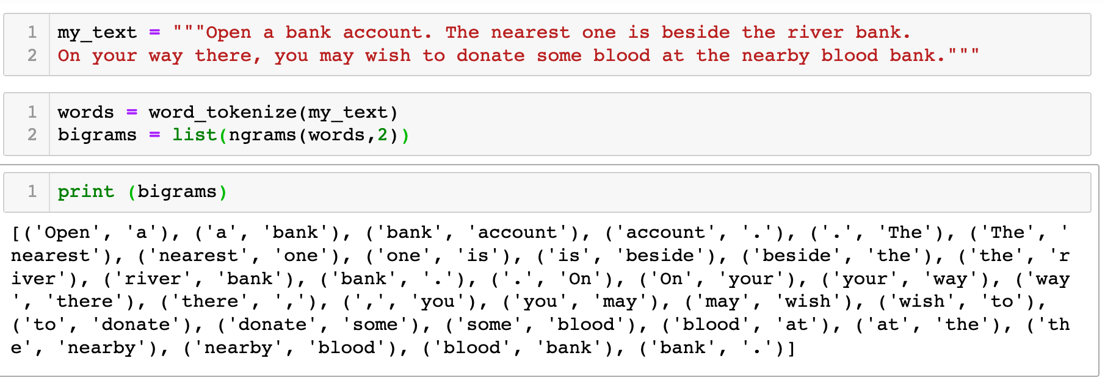
Code: Tokenization (N-Grams)
Tokenization by bi-grams retains some meaning the word "bank"
(blank, account), (river bank), (blood bank)
Ref er to nltk-example-5-tokenization-ngram.ipynb
Notes:
Let us use another example for a change. The Mr Smith one isn't a great one to illustrate the concept
In this sentences, the 5.1 token by itself is quite meaningless. But if we can retain the link to billion, we can retain information on that it is referring to some monetary value

Slide 19
Tokenization is language dependent
Chinese: 如果您在新加坡只能前往一间夜间娱乐场所，Zouk必然是您的不二之选。
English: If you only have time for one club in Singapore, then it simply has to be Zouk.
Example from tSource: https://www.aclweb.org/anthology/Y11-1038
Tutorial for Chinese words tokenization can be found at https://michelleful.github.io/code-blog/2015/09/10/parsing-chinese-with-stanford/

Slide 20
Tokenization is domain specific
Mutants in Toll signaling pathway were obtained from Dr. S. Govind: cactE8, cactIIIG, and cactD13 mutations in the cact gene on Chromosome II.
The maximal effect is observed at the IL-10 concentration of 20 U/ml.
Source: https://www.cs.cmu.edu/~ark/EMNLP-2015/proceedings/LOUHI/pdf/LOUHI05.pdf

Slide 21
Exercise
Refer to nltk-exercise-1-tokenization.ipynb
Tokenization
Notes:
We are going to use the remaining of the time to get our self familiar with regular expression.
We will first start with you getting use to the syntax of the RE. Generally, the syntax is language independent. So when you figure out for Python, you can easily apply to another language.
(30 mins)
The, we look at the RE module in Python. We will focus on using some of the common methods found the RE to perform search and subsititute methods.
(30 mins)
Finally, we look into how we can use RE to perform some preliminary understanding of a corpus of text.
(30 mins)

Slide 22
Preprocessing Checkpoint
Turn text into a meaningful format for analysis
Tokenization
Clean the data
Remove - capital letters, punctuation, stop words
Normalization - Stemming, Lemmatization
Chunking - compound terms, multi-words phrases
Notes:
Tokenization is the process of dividing our data into the smaller units that we will analyze
Chunking is a general term. It means to extract meaningful units, or chunks, of text from raw text.

Slide 23
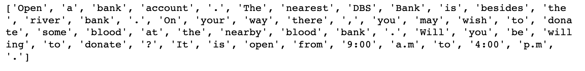
Preprocessing: Remove Punctuation and Upper case
Open a bank account. The nearest DBS Bank is besides the river bank. On your way there, you may wish to donate some blood at the nearby blood bank. Will you be willing to donate? It is open from 9:00 a.m to 4:00 p.m.
The end of sentence punctuations (e.g. full stop , question mark) may be irrelevant.
The tokens (Open, open) and (The, the) are the same words, with same meaning.
Notes:
Why do we want to remove these things? They impede our analysis of the text. To analyze texts, we want a uniform format that we can read in a consistent way. Therefore, we try to remove some of the ‘artifacts’ that are language-specific and don’t contribute to the meaning of the text.
The major ways to normalize texts are in the removal of punctuation, capital letters, and numbers.

Slide 24
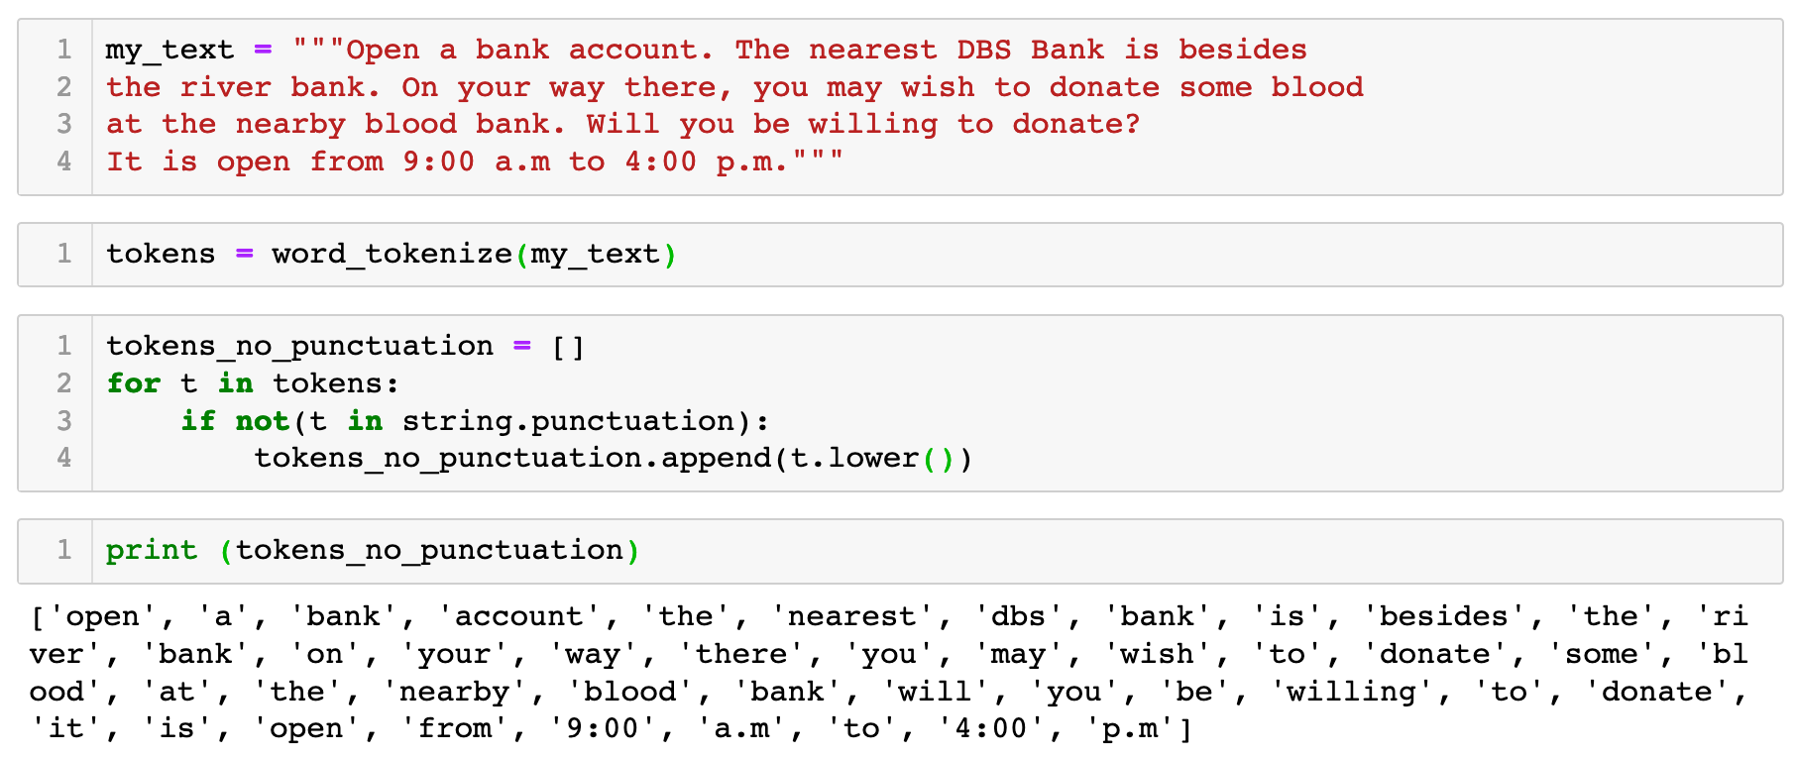
Code: Remove Punctuation and Change to Lower Case
Refer to nltk-example-6-punctuation-lowercase.ipynb
Notes:
Lecturer Notes:

Slide 25
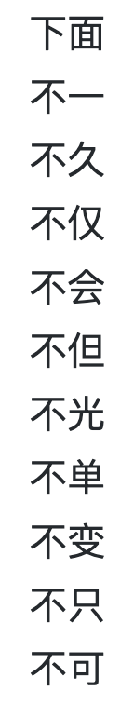
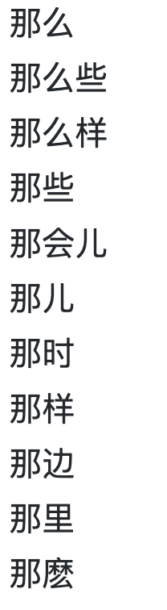
Stop Words
Stop words are hi-frequency common words in languages that carry much less substantial information about the meaning of some text
Notes:
Typically the stop words are grammar types or the co

Slide 26
Example: Text Without Stop Words
The History of Humanity is part of UNESCO’s General and Regional Histories Collection. The publication seeks to contribute to mutual understanding and dialogue between cultures and civilizations. This series seeks to illustrate the encounters between cultures across history and their respective contributions to the general progress of humankind. This is done through the promotion of a pluralist vision of history."
source: https://en.wikipedia.org/wiki/History_of_Humanity
Discussion:
Will we lose meaning and context if some words are removed?
Notes:
Stop words don’t contribute to the meaning of the text and so for our purposes will just confuse the algorithm.
For example, the word ‘some’ doesn’t tell us anything meaningful about what’s going on in this text.
On the next slide, there are some of the commonly removed stop words.

Slide 27
Example (full text)
"The History of Humanity is part of UNESCO’s General and Regional Histories Collection. The publication seeks to contribute to mutual understanding and dialogue between cultures and civilizations. This series seeks to illustrate the encounters between cultures across history and their respective contributions to the general progress of humankind. This is done through the promotion of a pluralist vision of history."
source: https://en.wikipedia.org/wiki/History_of_Humanity
Notes:
Stop words don’t contribute to the meaning of the text and so for our purposes will just confuse the algorithm.
For example, the word ‘some’ doesn’t tell us anything meaningful about what’s going on in this text.
On the next slide, there are some of the commonly removed stop words.

Slide 28
Stop Words Corpus in NLTK
NLTK provides a corpus of stop words for the following languages:
Arabic, Azerbaijani, Danish, Dutch, English, Finnish
French, German, Greek, Hungarian, Indonesian, Italian
Kazakh, Nepali, Norwegian, Portuguese, Romanian
Russian, Slovene, Spanish, Swedish, Tajik

Slide 29
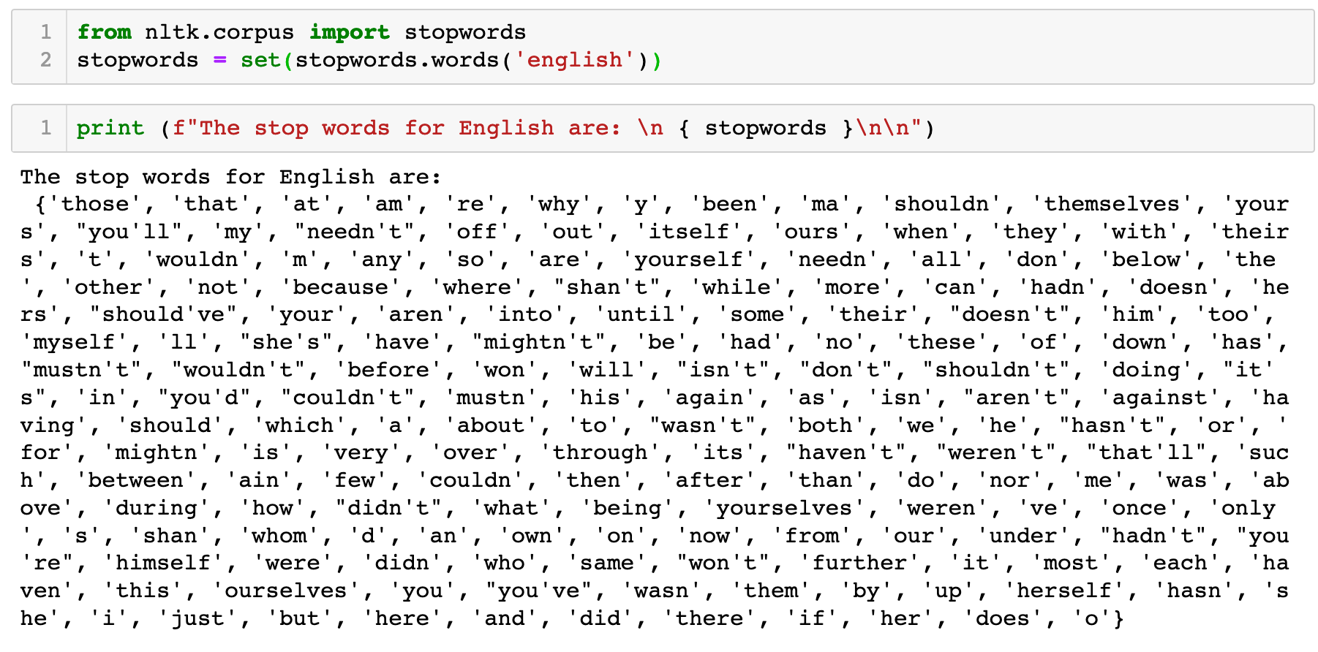
English Stop Words
Refer to nltk-example-7-stopwords-corpus.ipynb
Notes:
The nltk corpus already comes with a list of stopwords that are commonly removed for text analysi.
There isn't a universal list of stop words and the one provided by NLTK does change time to time.
If you do not like it, you can also create your list of stop words and input as a file.
Other prebuilt stopwords in NLTK inclued:
arabic
azerbaijani
danish
dutch
english
finnish
french
german
greek
hungarian
indonesian
italian
kazakh
nepali
norwegian
portuguese
README
romanian
russian
slovene
spanish
swedish
tajik
turkish

Slide 30
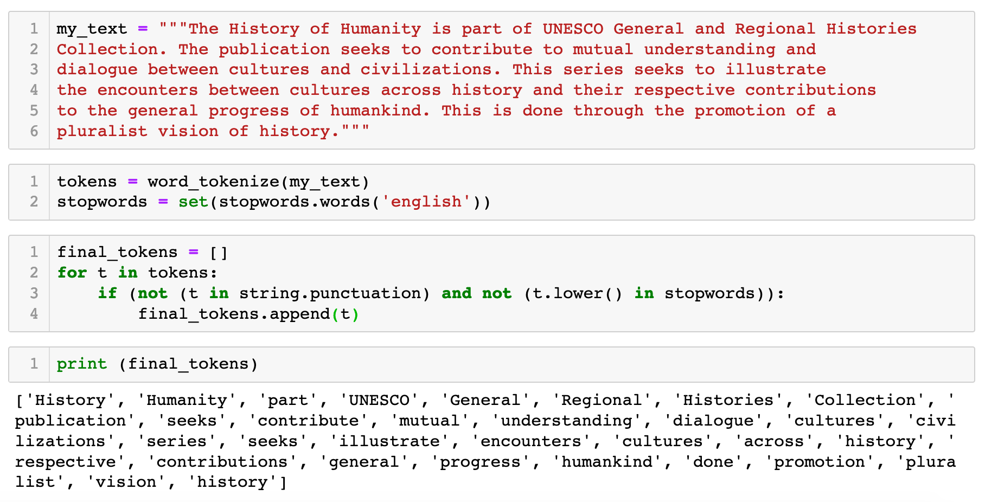
Code: Remove Stop Words from Text
Refer to nltk-example-8-using-stopwords.ipynb

Slide 31
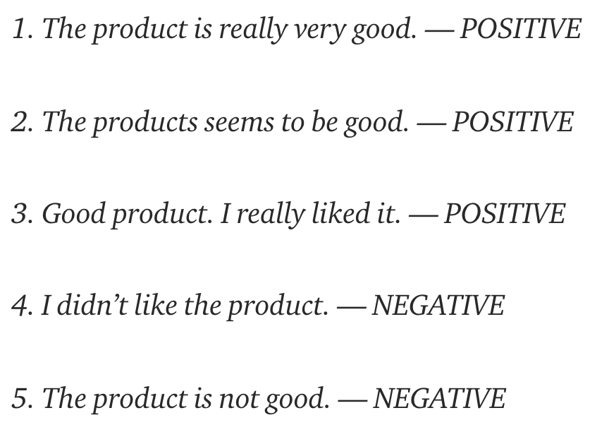
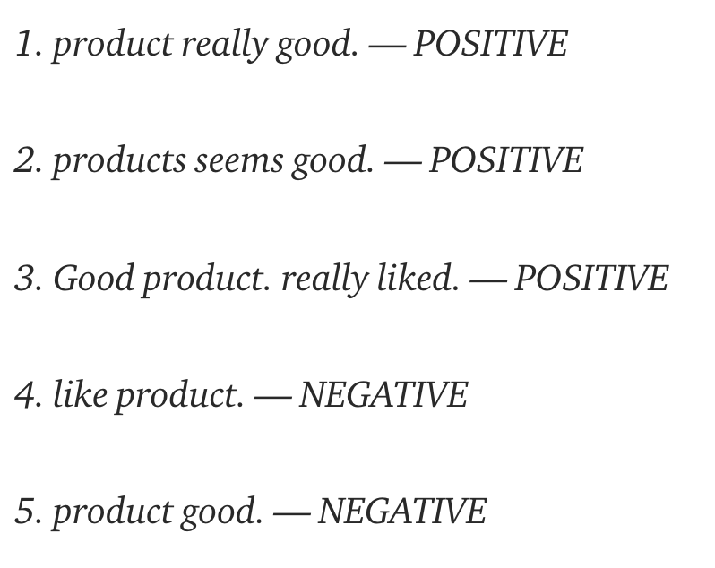
Danger: removing stop words may affect meaning
Text and labels for sentiment analysis of product reviews – before stopword removal
Text and labels for sentiment analysis of product reviews – after stopword removal
Example from: https://towardsdatascience.com/why-you-should-avoid-removing-stopwords-aa7a353d2a52
Notes:
If you are working with basic NLP techniques like BOW, Count Vectorizer or TF-IDF(Term Frequency and Inverse Document Frequency) then removing stopwords is a good idea because stopwords act like noise for these methods. If you working with LSTM’s or other models which capture the semantic meaning and the meaning of a word depends on the context of the previous text, then it becomes important not to remove stopwords.

Slide 32
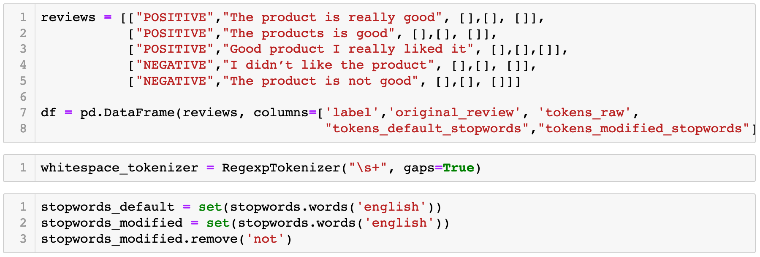
Code: Remove "not" from the Stop Words
Refer to nltk-example-9-using-stopwords-customisation.ipynb
Continue next page →
Notes:
Somethings you may have a requirement to add a stop word such as OMG to it. You simply just call the .add method to add to the set {}
Sets in Python. A Set is an unordered collection data type that is iterable, mutable and has no duplicate elements. Python's set class represents the mathematical notion of a set. ... This is based on a data structure known as a hash table.
Using a set is good, because duplicates are not represented. Also, you can remove some item using the remove() method

Slide 33
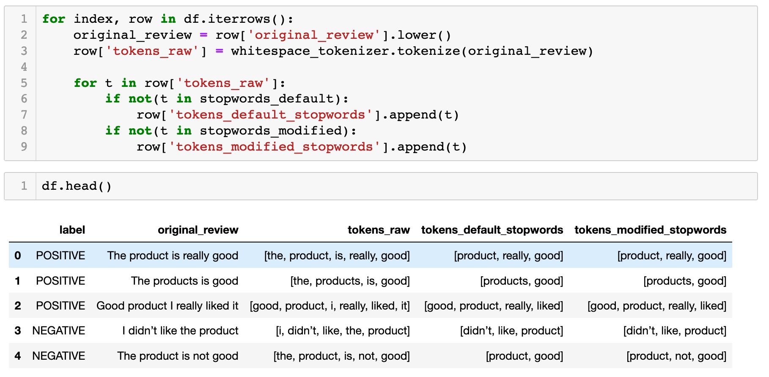
Code: Remove "not" from the Stop Words
Notes:
Somethings you may have a requirement to add a stop word such as OMG to it. You simply just call the .add method to add to the set {}
Sets in Python. A Set is an unordered collection data type that is iterable, mutable and has no duplicate elements. Python's set class represents the mathematical notion of a set. ... This is based on a data structure known as a hash table.
Using a set is good, because duplicates are not represented. Also, you can remove some item using the remove() method

Slide 34
Preprocessing Techniques
Turn text into a meaningful format for analysis
Tokenization
Clean the data
Remove - capital letters, punctuation, stop words
Normalization - Stemming, Lemmatization
Chunking - compound terms, multi-words phrases
Notes:
Tokenization is the process of dividing our data into the smaller units that we will analyze
Chunking is a general term. It means to extract meaningful units, or chunks, of text from raw text.

Slide 35
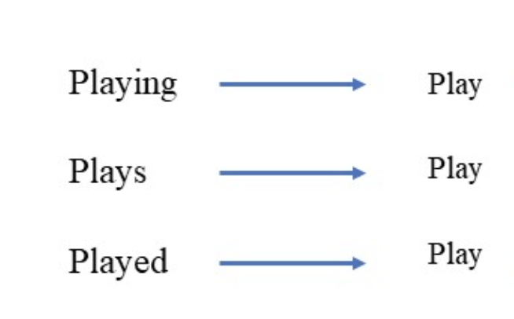
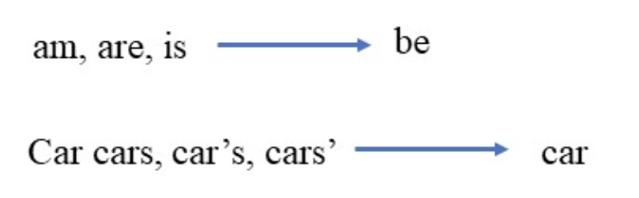
Normalization – Key Idea
What we speak and write are made up of several words often derived from one another.
Some words are derived from root words.
Normalized sentence
If we can cut down the number of unique words, we can reduce the size of the words in the text.
Example fom: https://www.datacamp.com/community/tutorials/stemming-lemmatization-python
Notes:
Stanford’s CoreNLP has different language options

Slide 36
Stemming
Caring → Car (wrong meaning!)
Cars → Car
Drawer → Draw
Happily → Happi (misspelling!)
Stemming refers to a crude heuristic process that chops off the ends of words in the hope of achieving this goal correctly most of the time, and often includes the removal of derivational affixes.
Problem
- Stemmed word does not have similar meaning to the original
- Stemmed word may not be a proper word found in the dictionary

Slide 37
Lemmatization
Careful , Caring → Care
Cars , car → Car
runs, running, ran → run
Lemmatization uses vocabulary knowledge and morphological analysis of words, normally aiming to remove inflectional endings only and to return the base or dictionary form of a word, which is known as the lemma.
Notes:
morphology is the study of words, how they are formed, and their relationship to other words in the same language. It analyzes the structure of words and parts of words, such as stems, root words, prefixes, and suffixes.

Slide 38
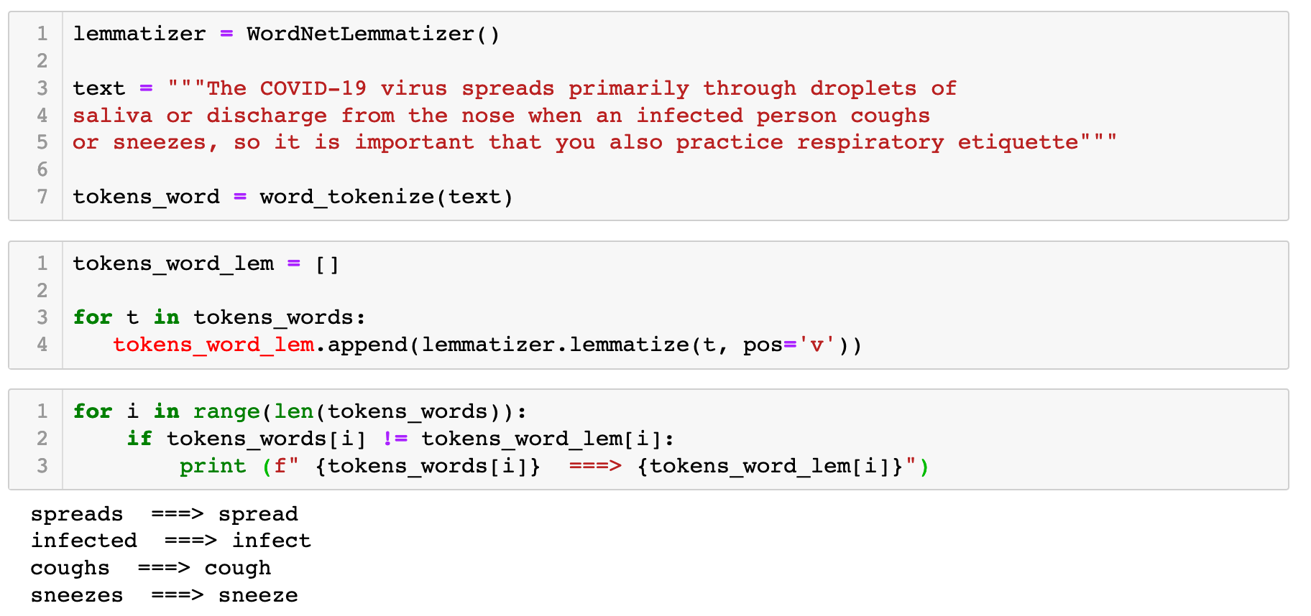
Code: Lemmatization
Treats word as verb
refer to nltk-example-10-lemmatization.ipynb
Notes:
We only demonstrate lemmtization as it a smarter way to normalize it considers the meaning of words better than stemming

Slide 39
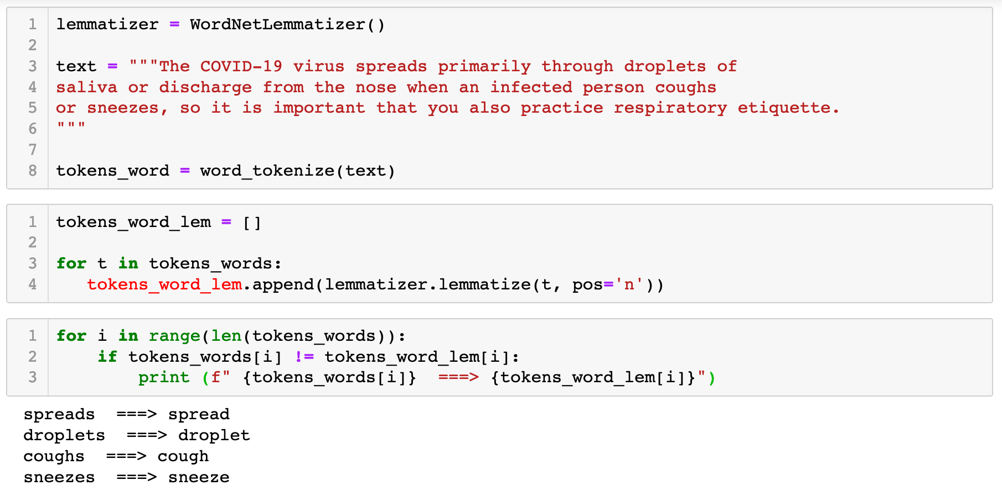
Code: Lemmatization
Treats word as noun
Notes:
We only demonstrate lemmtization as it a smarter way to normalize it considers the meaning of words better than stemming

Slide 40
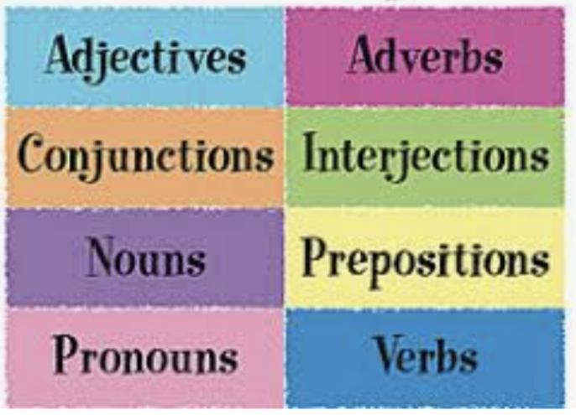
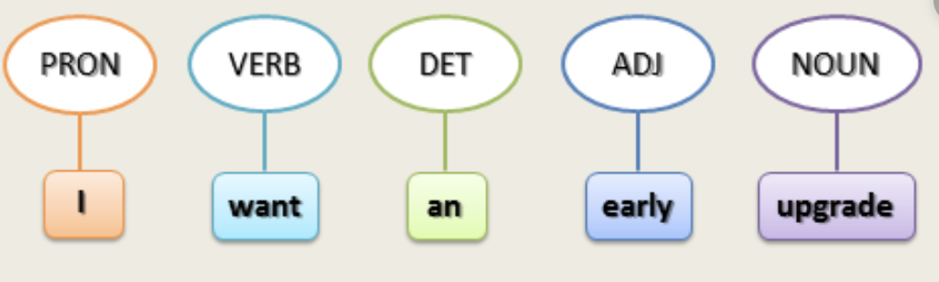
Preprocessing: Parts of Speech (POS) Tagging
Sentences contain nouns, verbs, adjectives, ...
Parts of speech tagging generates labels (grammar information) for each word
Having tags on nouns can reveal names, entities, places etc that are mentioned in the text
For lemmatization to work well, we need to pass the POS tags information
Notes:
Some words change meaning depending on their context in a sentence. For example, the word ‘run’ might be a verb (I like to run in the mornings) or a noun (How did your run go this morning?) depending on how it is used.
Thus part of speech tagging may help gain greater insight into the meaning of a text.
POS tagger is used to assign grammatical information of each word of the sentence.

Slide 41
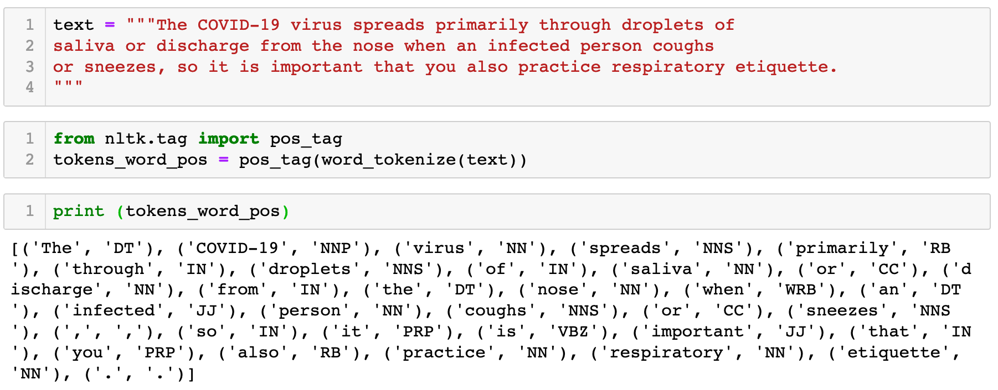
Code: POS Tags from Penn Treebank tags
NLTK uses the set of tags from the Penn Treebank Project
(https://www.ling.upenn.edu/courses/Fall_2003/ling001/penn_treebank_pos.html)
Refer to nltk-example-11-POSTagger.ipynb
Notes:
Thankfully, nltk has a built in tagger, so we all we need to do is call this pos_tag from the nltk library.
Some POS tags:
NN - is a noun
NNP – is a proper noun
JJ – is an adjective
IN – is a preposition
VBZ – is a verb, 3rd person sing. present takes

Slide 42
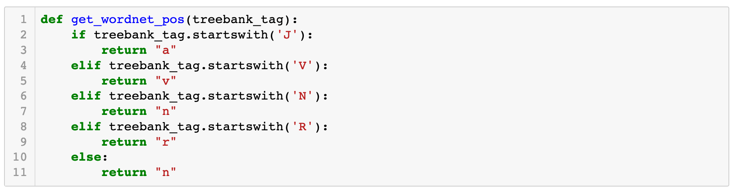
Convert between Wordnet and PennTreebank POS Tags
Lemmatizer uses tags that follows WordNet convention - v – verb, n – noun, r – adverb, a - adjective
Refer to nltk-example-12-POSTagger-Lemmatizer.pynb
Continue next page →
Notes:
Thankfully, nltk has a built in tagger, so we all we need to do is call this pos_tag from the nltk library.
Some POS tags:
NN - is a noun
NNP – is a proper noun
JJ – is an adjective
IN – is a preposition
VBZ – is a verb, 3rd person sing. present takes

Slide 43
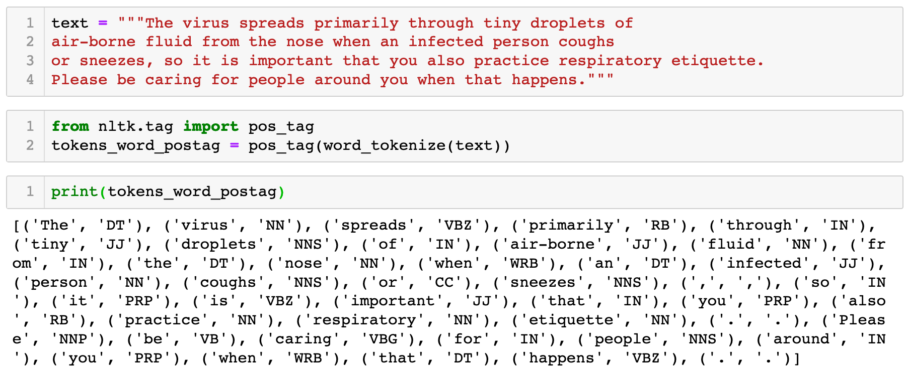
Code: Lemmatization with POS
Refer to nltk-example-12-POSTagger-Lemmatizer.pynb
Continue next page →
Notes:
We find the list with all possible POS tags used by the Natural Language Toolkit (nltk) with nltk.help.upenn_tagset() or nltk.help.upenn_tagset('RB’) for information on a specific tag.

Slide 44
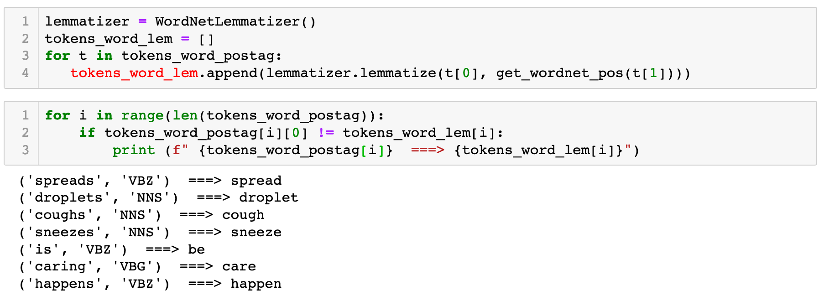
Code: Lemmatization with POS
Refer to nltk-example-12-POSTagger-Lemmatizer.pynb
Notes:
We find the list with all possible POS tags used by the Natural Language Toolkit (nltk) with nltk.help.upenn_tagset() or nltk.help.upenn_tagset('RB’) for information on a specific tag.

Slide 45
Preprocessing Techniques
Turn text into a meaningful format for analysis
Tokenization
Clean the data
Remove - capital letters, punctuation, numbers, stop words
Normalization - stemming, lemmatization
Chunking - compound words, multi-words phrases
Notes:
Tokenization is the process of dividing our data into the smaller units that we will analyze
Chunking is a general term. It means to extract meaningful units, or chunks, of text from raw text.

Slide 46
Preprocessing: Chunking
What is the right way to tokenize open compound words?
We need to invest in data science and artificial intelligence capabilities.
"data", "science“ or "data science"
"artificial" , "intelligence" or "artificial intelligence"
Mr Heng Swee Keat will deliver a Ministerial Statement on additional support measures for COVID-19 pandemic.
"heng", "swee“ , "keat"
or "heng swee keat"
or “heng_swee_keat”
Notes:
Compound term extraction again allows us to better preserve the meaning of our text.
Single word tokenization results in lose of meaning & changes the conceptual meaning

Slide 47
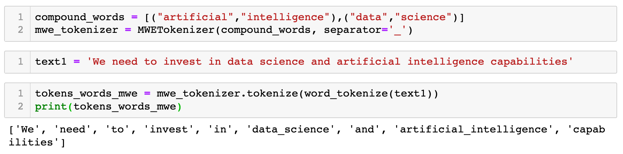
Code: Chunking using MWE Tokenizer
Refer to nltk-example-13-Chunking-MWE.ipynb
Notes:
This is a way to manually do it in NLTK
Note that this MWE tokenizer is case sensitive. To make it work better, you’d need to make everything lowercase to begin with.
A MWETokenizer takes a string which has already been divided into tokens and retokenizes it, merging multi-word expressions into single tokens, using a lexicon of MWEs:

Slide 48
Other cleansing issues
Acronym normalization and tagging – acronyms can be specified as “I.B.M.” or “IBM” so these should be tagged and normalized.
Remove special characters in scraped text from web pages and PDF files
Identify and remove useless sections, such as common headers, footers, and sidebars as well as legal or commercial boilerplates
Spelling correction - misspelled errors are encountered especially if you are processing text from crowd-sourced or informal sources
Expanding contraction (I'd → I would)
Notes:
Recognising entities in a legal document is very important. Knowing the name of the parties involved, Dates, location of the incident etc. solves 30% of your task

Slide 49
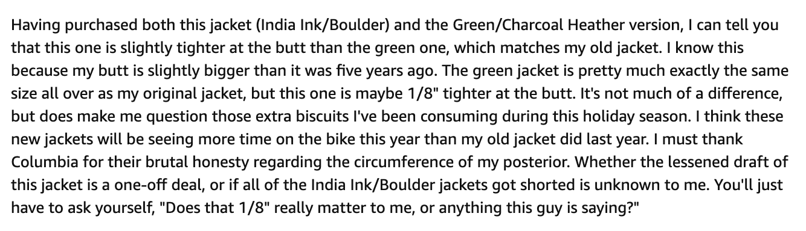
Knowledge Check
Given the text below, what are some preprocessing techniques you could apply?
Source: Amazon product review
Notes:
Brainstorm as a group. There were a lot of terms that were covered.
As a class activity, suggest the techniques and steps to undertake

Slide 50
Optional Learning Video
NLP - Text Preprocessing and Text Classification (using Python)
- https://youtu.be/nxhCyeRR75Q
Notes:
Brainstorm as a group. There were a lot of terms that were covered.
As a class activity, suggest the techniques and steps to undertake

Slide 51
Exercise
Refer to nltk-exercise-2-text-preprocessing.ipynb
Notes:
We are going to use the remaining of the time to get our self familiar with regular expression.
We will first start with you getting use to the syntax of the RE. Generally, the syntax is language independent. So when you figure out for Python, you can easily apply to another language.
(30 mins)
The, we look at the RE module in Python. We will focus on using some of the common methods found the RE to perform search and subsititute methods.
(30 mins)
Finally, we look into how we can use RE to perform some preliminary understanding of a corpus of text.
(30 mins)

Slide 52
References
Natural Language Toolkit, https://www.nltk.org/
Text Wrangling & Pre-processing: A Practitioner’s Guide to NLP, https://www.kdnuggets.com/2018/08/practitioners-guide-processing-understanding-text-2.html
Text Wrangling & Pre-processing: A Practitioner’s Guide to NLP, https://towardsdatascience.com/nlp-text-preprocessing-a-practical-guide-and-template-d80874676e79

